Slide 1



Project Number: 15002901
Mentor: Dror Margalit
Briefly
Workshop: Software product development entrepreneurship
Gil Kravitz
Dor Edelman
Ofek Ram Smadja
Maor Halevi
Github Repo

Slide 2

Briefly
From Problem To Solution
Problem
Current news applications overwhelm users with generic news feeds and lengthy articles, causing information overload. This makes it difficult for users to stay updated on topics that interest them without spending much time scrolling and reading.
Why It Matters
In today’s fast-paced world, people demand a time-efficient way to stay informed. They want quick access to relevant news without the hassle of navigating through extensive content.

Slide 3
Briefly
From Problem To Solution
Solution - REDUCE. SCROLLING. TIME.
Your most precious asset is time; our platform allows the users to reduce scrolling time and accomplish more in less time. Our solution not only keeps the users informed but does so in a way that respects their time and attention.
What Makes Us Better?
Unique Feature
Technological Edge
Our platform offers personalized feeds to users, delivering concise summaries of the latest news articles. This ensures that users receive content tailored to their interests in a brief and engaging manner.
OUR personalized news summaries feed reduce information overload and enhance user engagement by focusing on what matters most.
Utilizes advanced AI algorithms to curate and summarize news, ensuring relevancy.

Slide 4
Briefly
Product Concept
Our product is a news platform that offers brief summaries of breaking news from various sources. Users can quickly access news highlights in short snippets, providing a user-friendly and time-saving method to stay informed without extensive reading or navigation. Our goal is to provide a smooth news consumption experience that keeps users informed about the latest news.

Slide 5
Briefly
Market Analysis
Target Market
Busy professionals, students, and anyone who values time efficiency and quick news consumption, preferring concise summaries over long articles.
Market Size
4.2 million potential users in the Israeli digital news market, representing approximately 60% of the adult population.
Competitors
Major Israeli news sites (Ynet, Haaretz, N13, N12), international platforms (Google News, MSN), and popular Telegram channels.

Slide 6
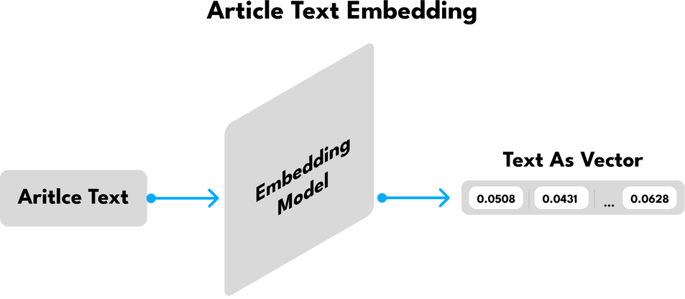
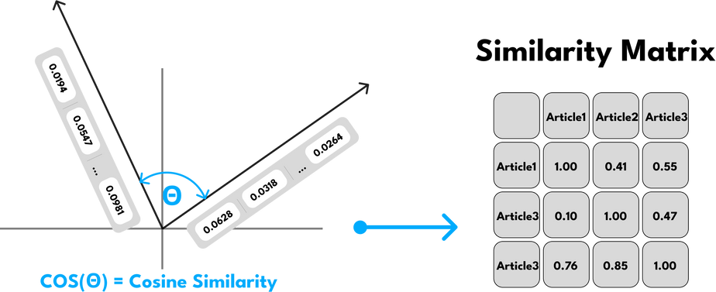
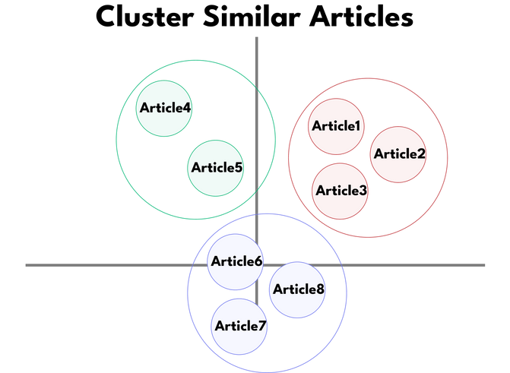

Briefly
The Product Core
Each article get into Open-AI Embedding Model
Cosine similarity is applied to each pair of article vectors to calculate the similarity matrix.
Group articles into clusters when their similarity score exceeds a specified threshold.

Slide 7
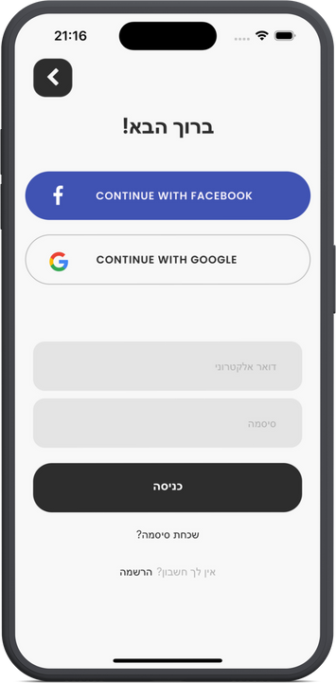
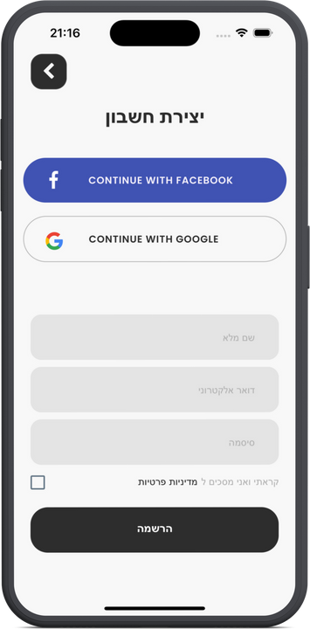
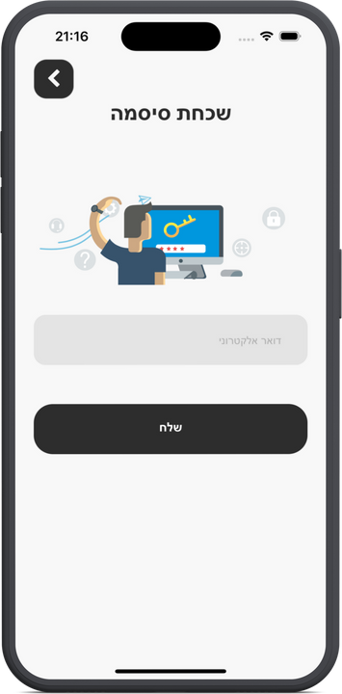
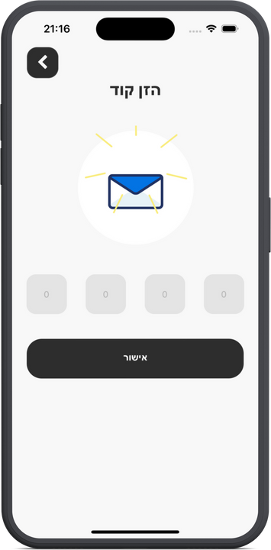
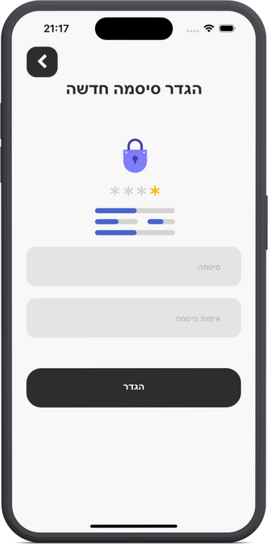

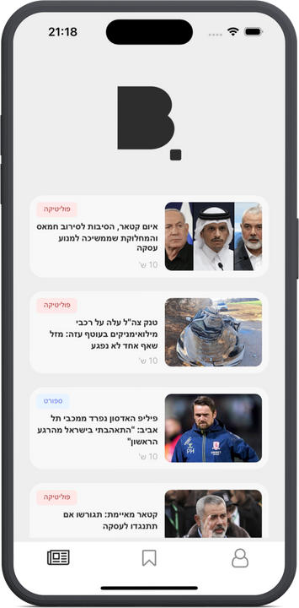
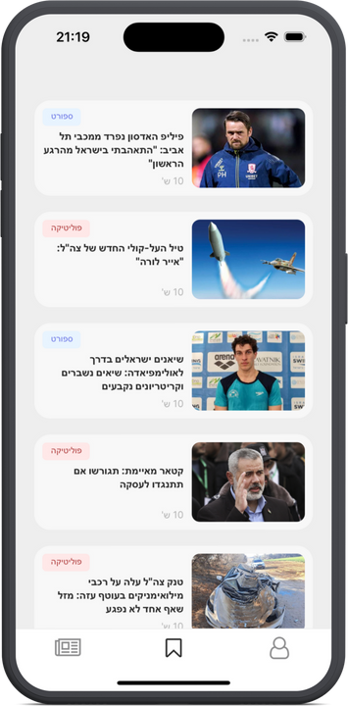
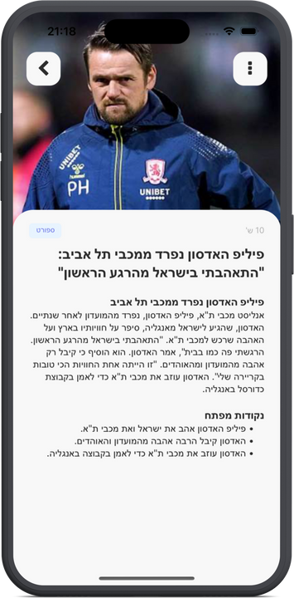
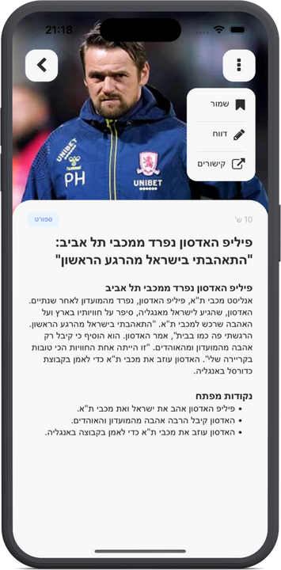
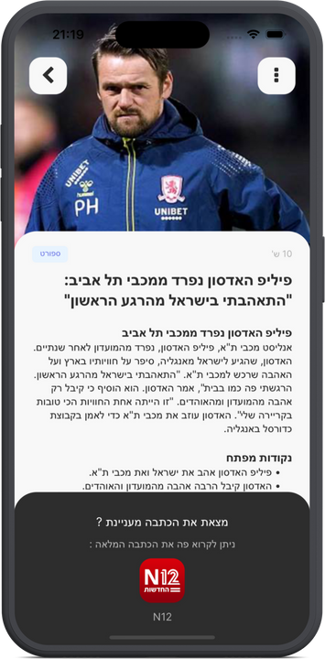
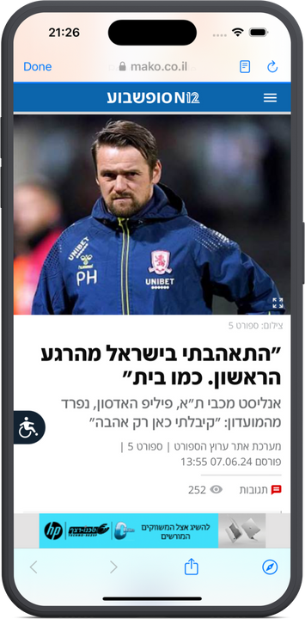
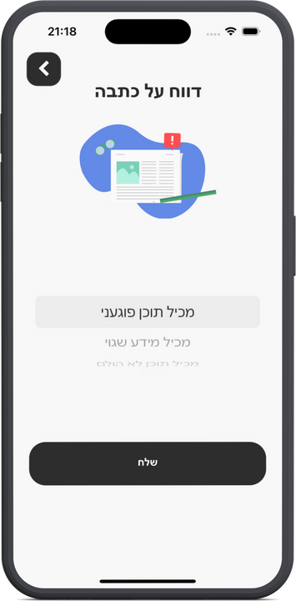
Briefly
App Screens

Slide 8
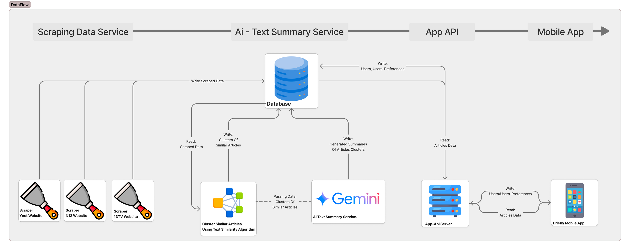
Briefly
Data Flow

Slide 9
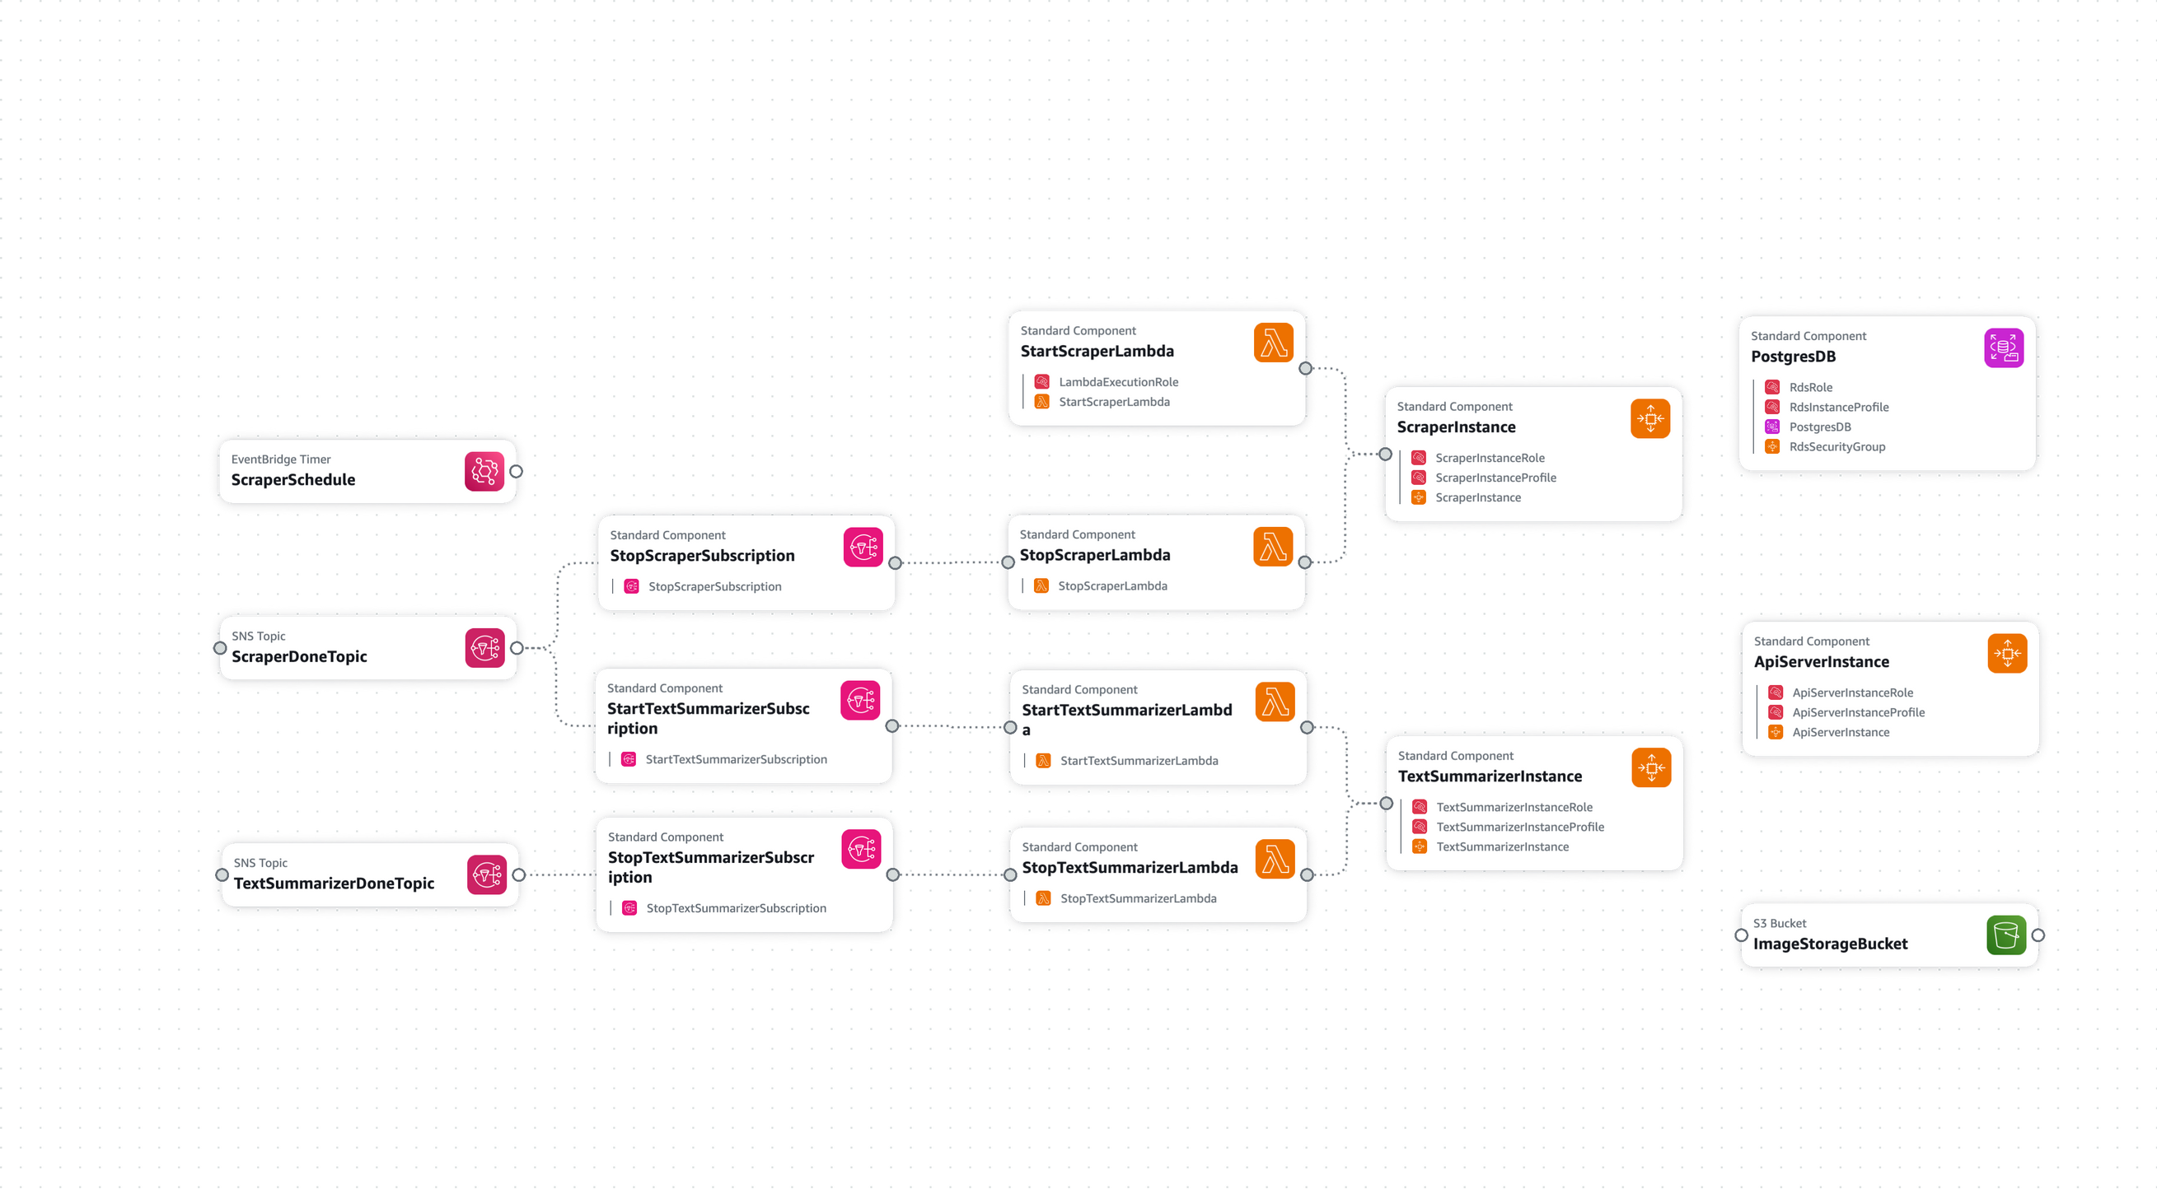
Briefly
Cloud Architecture

Slide 10
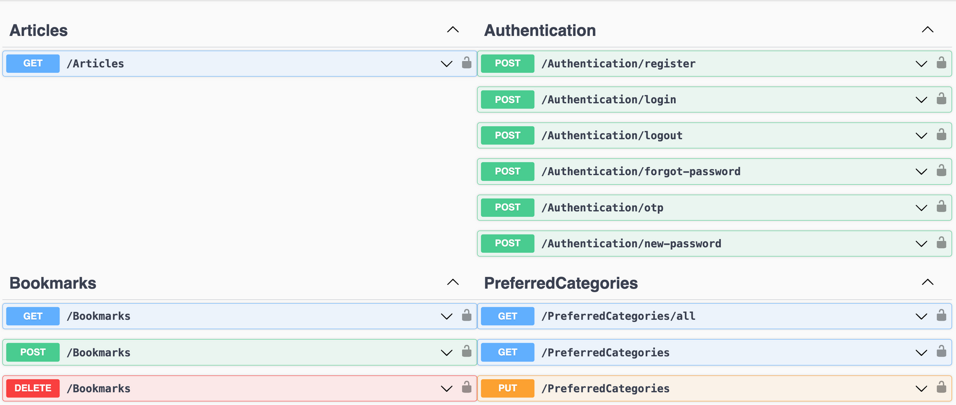
Briefly
API Structure
Backend Swagger Api Documentation

